Slide 1

How to access GMCR via Adastra (OOH)
A step-by-step guide

Slide 2
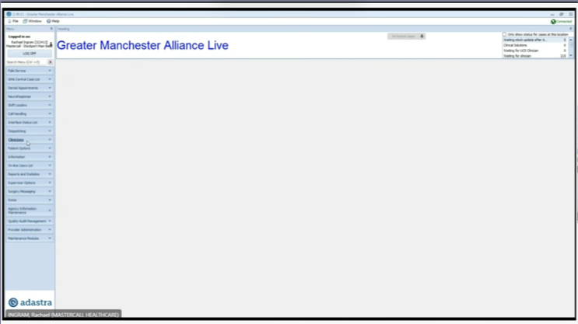
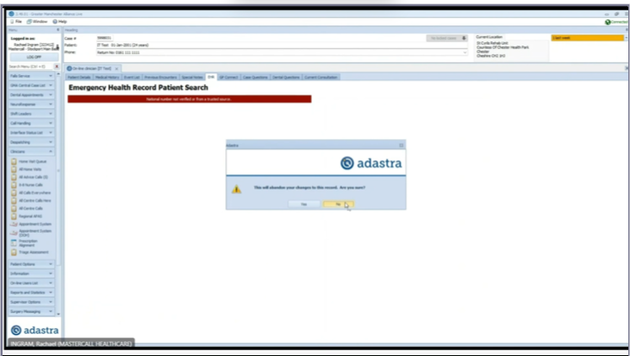
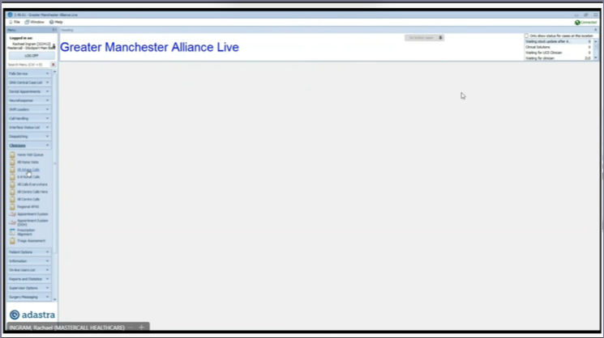
Click on Clinician to expand menu
3. To launch GMCR click on EHR
2. Select 'All advice Calls'

Slide 3
FAQ and more training resources
Step-by-step video on how to access GMCR via Adastra with a brief overview of GMCR: https://www.youtube.com/watch?v=wVFfzFTvLb0
Is GMCR EPaCCS available to all OOH staff? All Out-of-hours (OOH) staff can access EPaCCS plans
Can OOH staff edit or create a GMCR EPaCCS? OOH staff are not expected to create the EPaCCS, as they typically do not have the initial conversation with the patient. We are currently working on increasing usage, and after this engagement, we will grant edit access.

Slide 4
FAQ and more training resources
Can you see data from other OOH providers? This is currently a work in progress, so at the moment, data is only visible from Mastercall. However, soon data from other providers, such as Bardoc, will also be available.
Can you see clinical letters from all secondary care providers? Clinical letters, discharge summaries, and some other documents from secondary care providers can be accessed under ‘Clinical Letters.’ However, not all secondary care providers, such as MFT, are currently contributing this information.

