Slide 1
GMCR V4 Deployment Differences between V3 and V4: Comparing Screenshots Seán Bradbury Senior Project Manager, NHS GM April 2025

Slide 2


V3 v V4

Slide 3
V3 v V4
SINGLE LAYOUT OPTION
2 OR 3 COLUMN LAYOUT

Slide 4
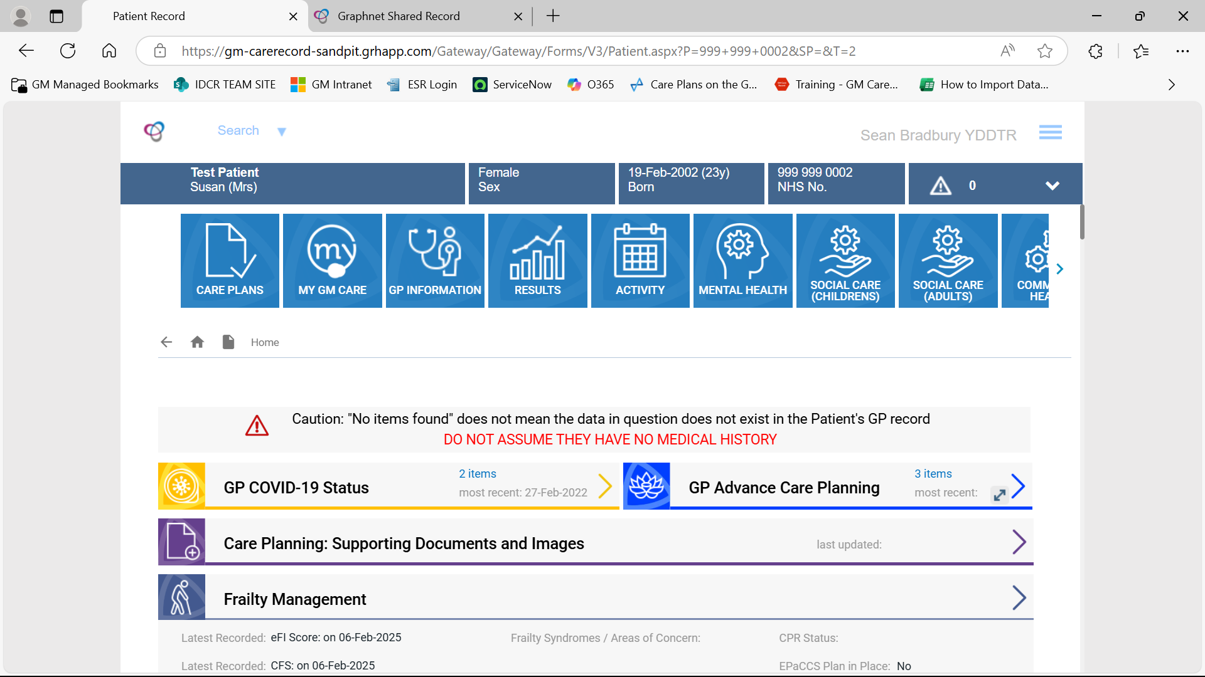
V3 Screenshot

Slide 5
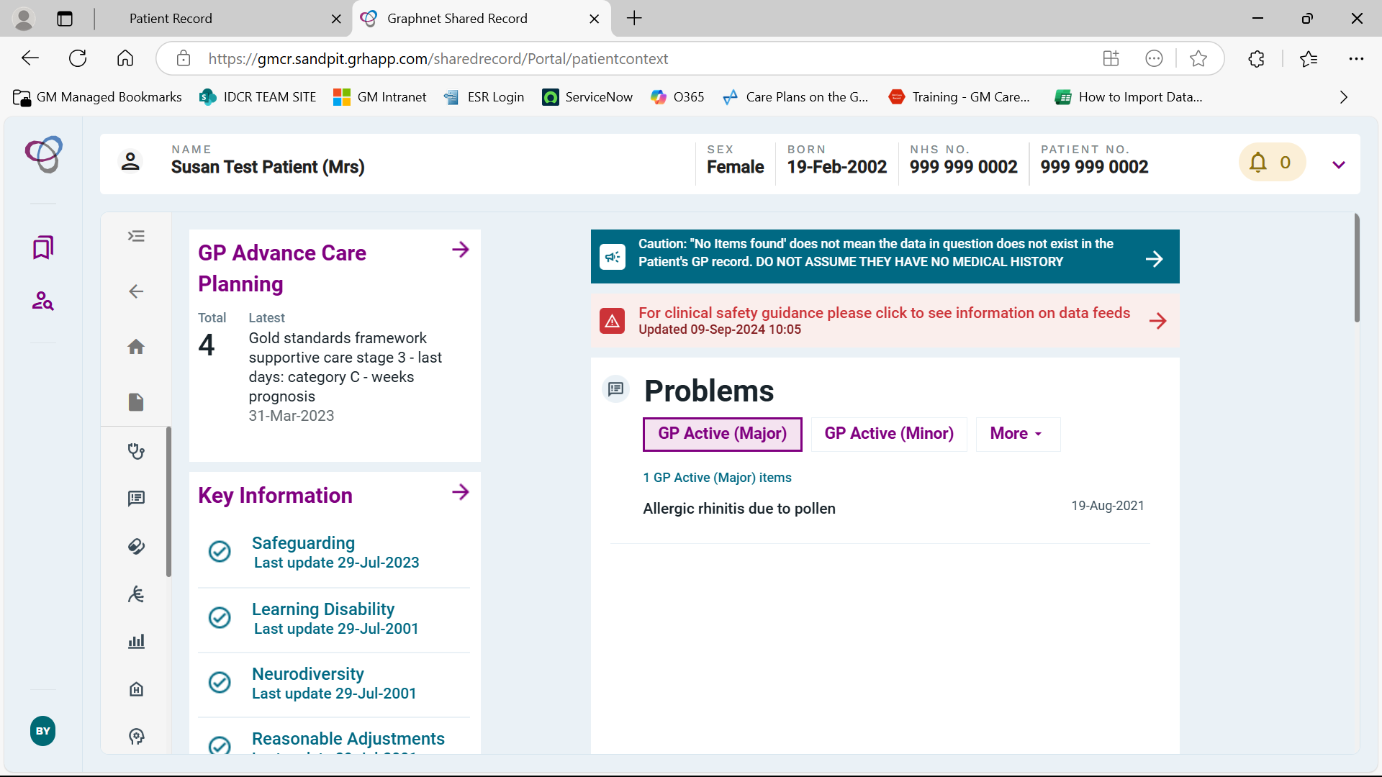
V4 Screenshot

Slide 6
V3 v V4
NAVIGATION
NAVIGATION

Slide 7
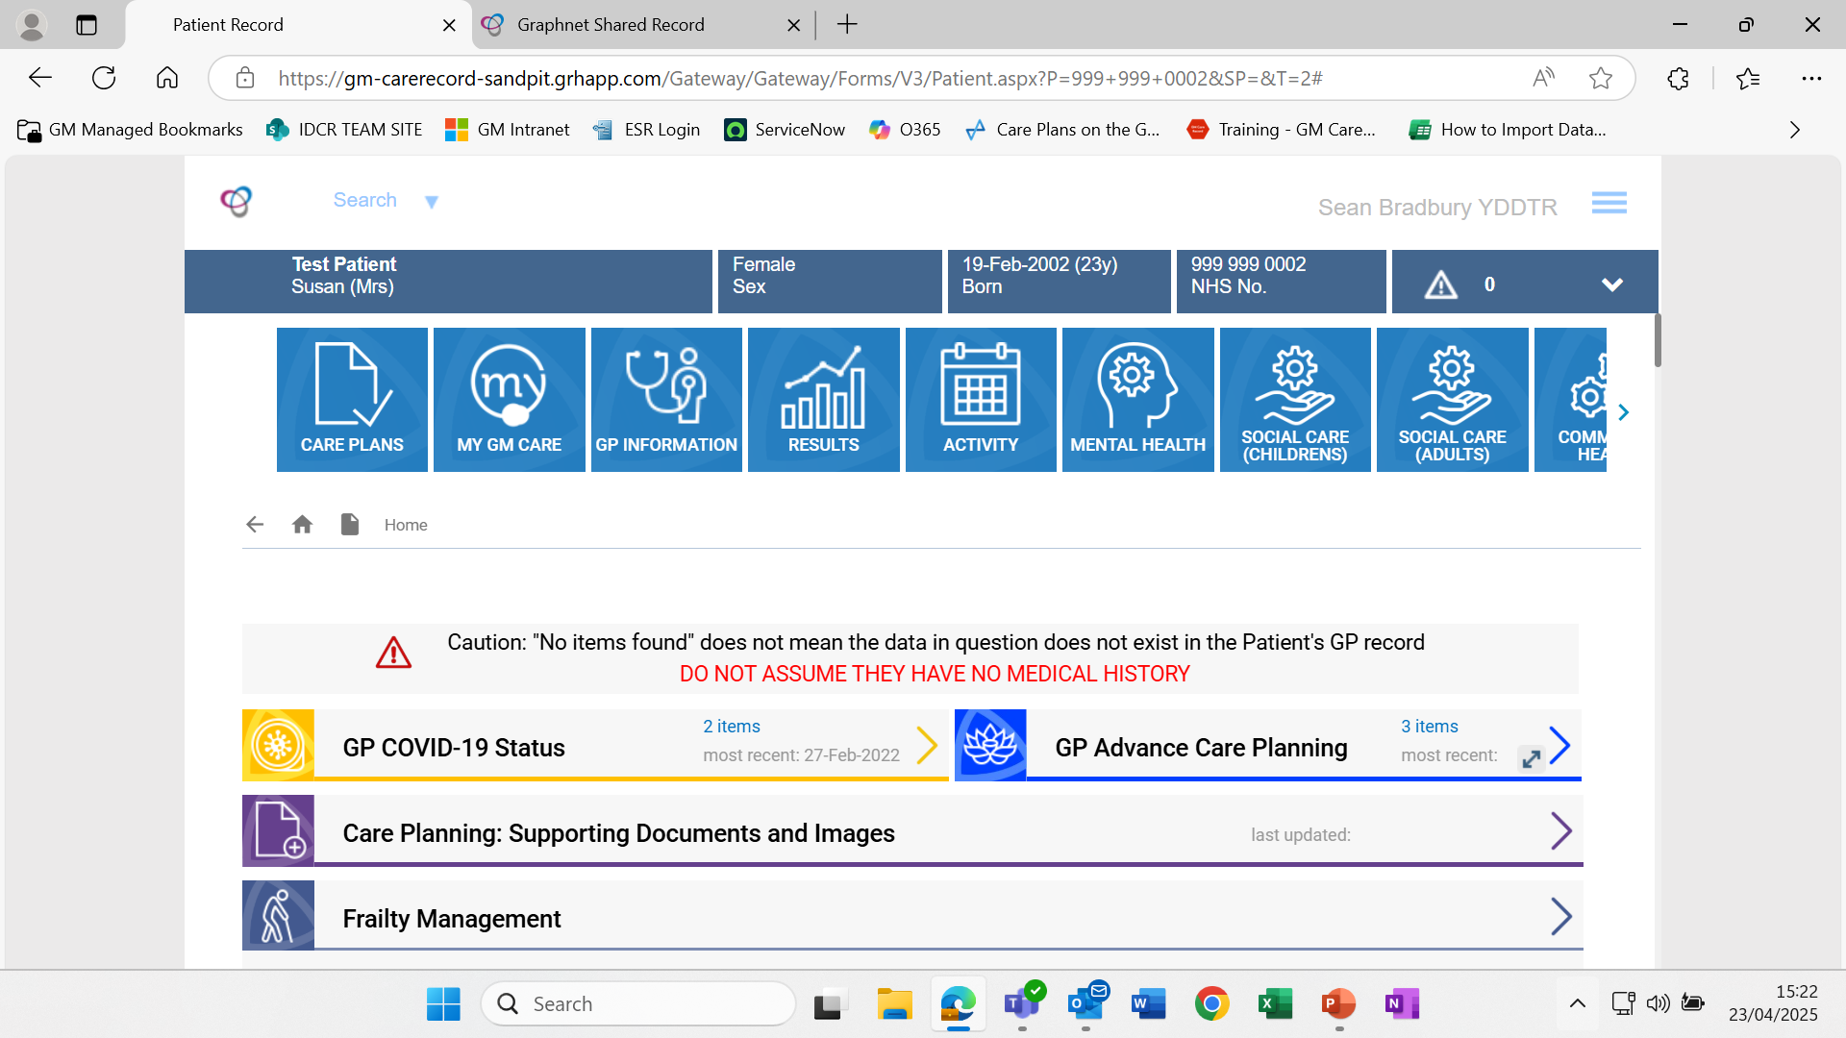
V3 Screenshot

Slide 8
V3 Screenshot

Slide 9
V3 Screenshot

Slide 10
V3 Screenshot

Slide 11
V3 Screenshot

Slide 12
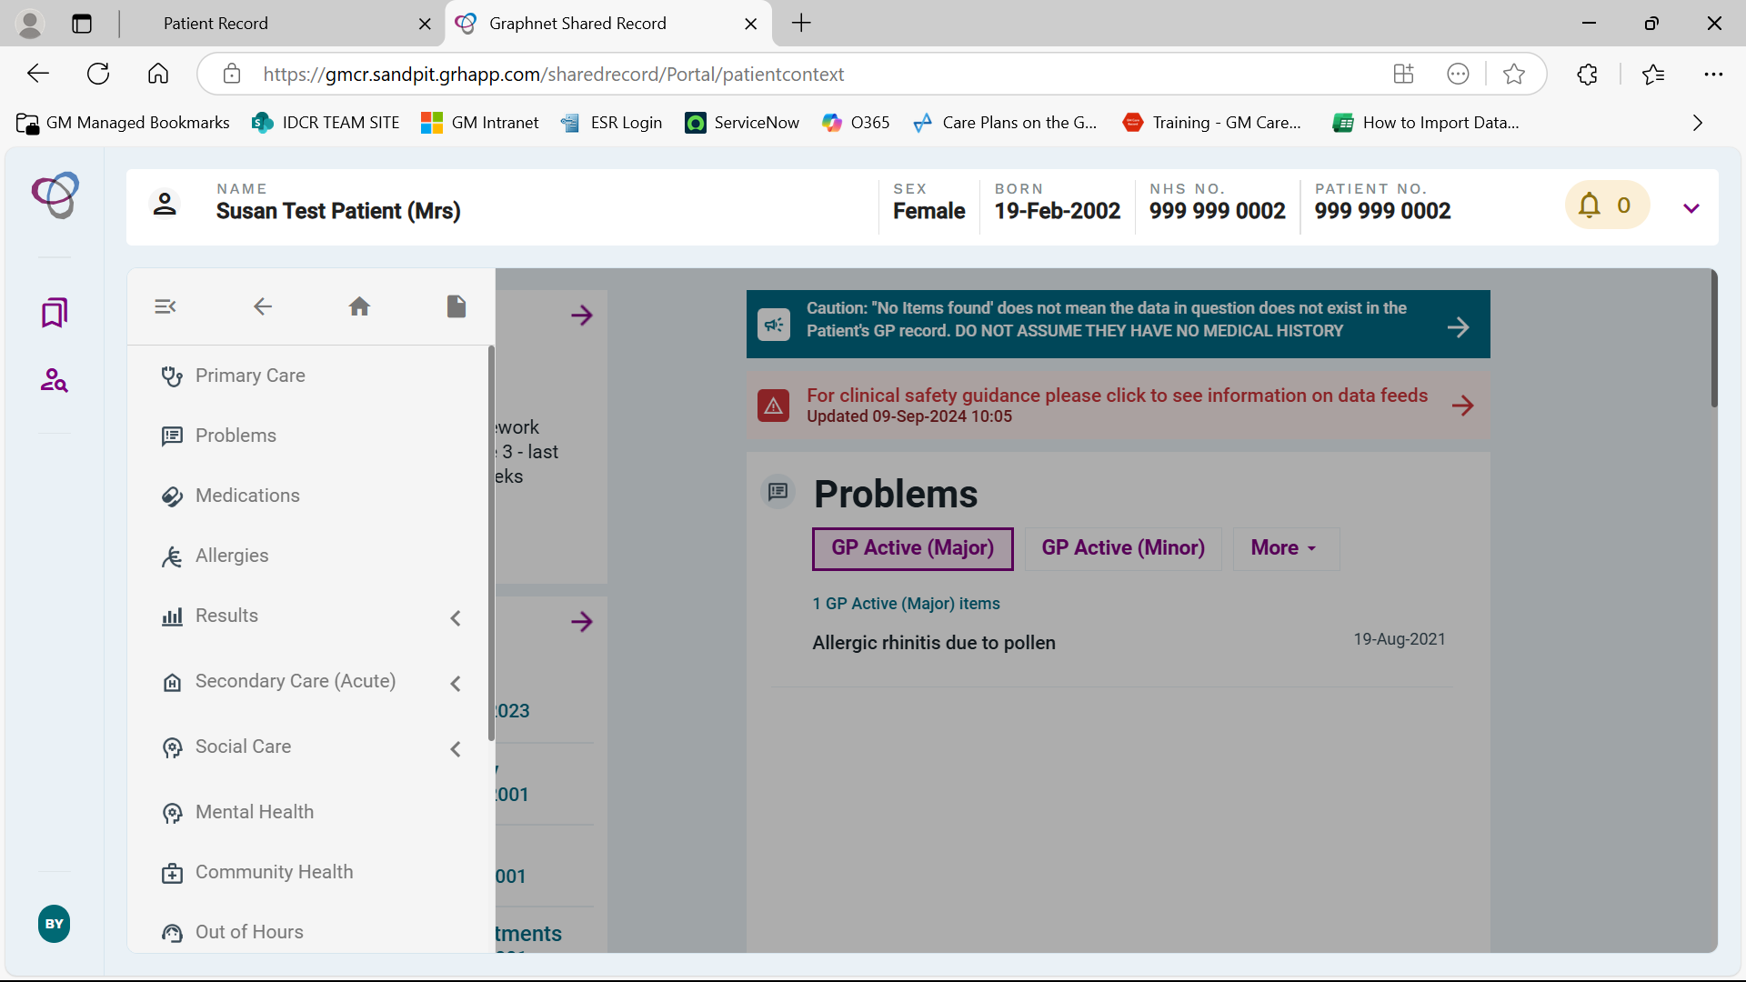
V3 Screenshot

Slide 13
V3 v V4
NAVIGATION
NAVIGATION
DATA SET GROUPING
MULTILE DATA LOCATIONS

Slide 14
V3 Screenshot

Slide 15
V3 Screenshot

Slide 16
V4 Screenshot

Slide 17
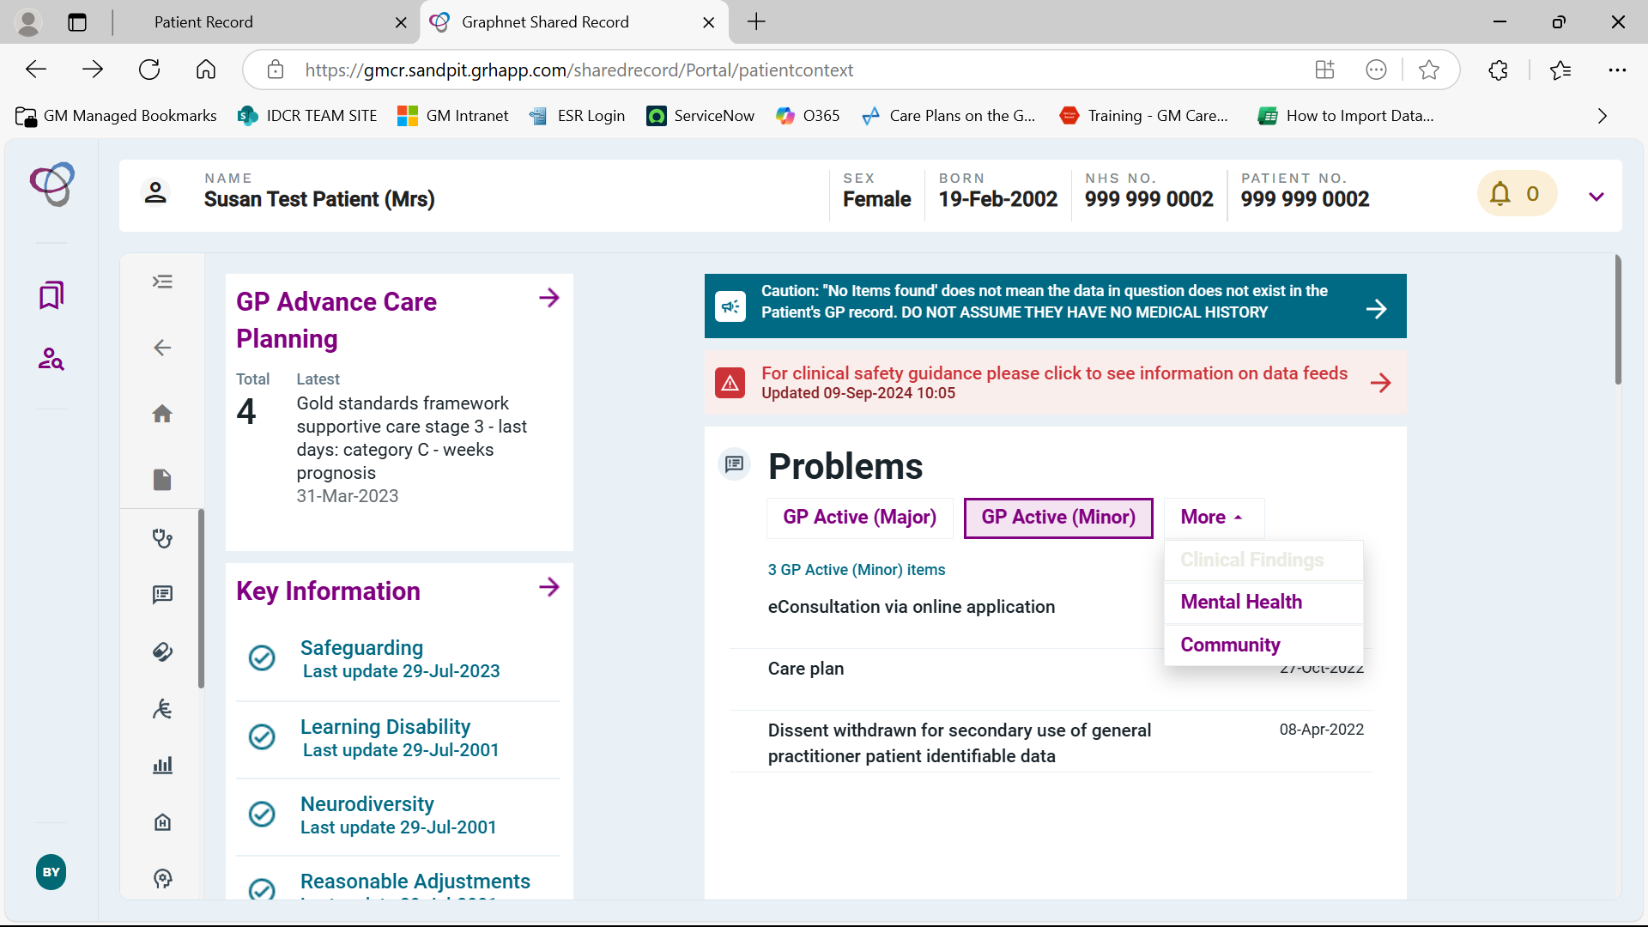


V4 Screenshot
EMPTY SPACE
NAVIGATION
DISPLAY SPACE MAXIMISED
V3 vs.V4

Slide 18
V3 Screenshot

Slide 19
V3 Screenshot

Slide 20
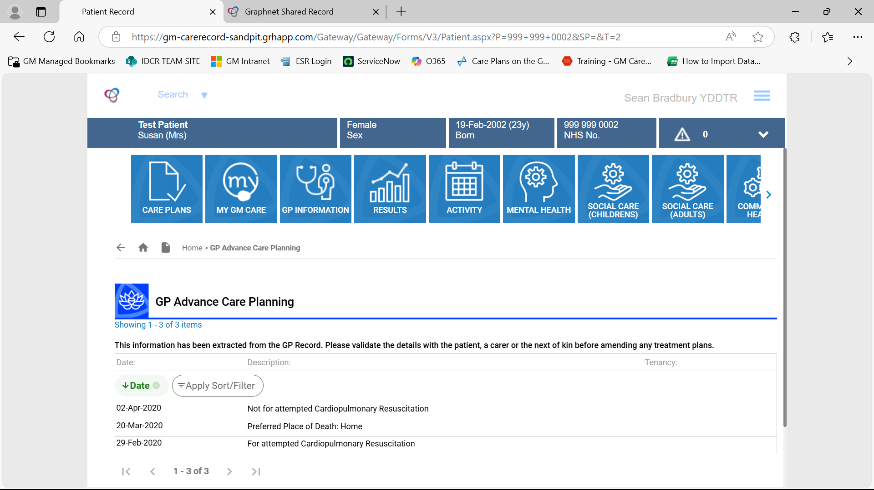
V3 Screenshot

Slide 21
V4 Screenshot

Slide 22
V4 Screenshot

Slide 23
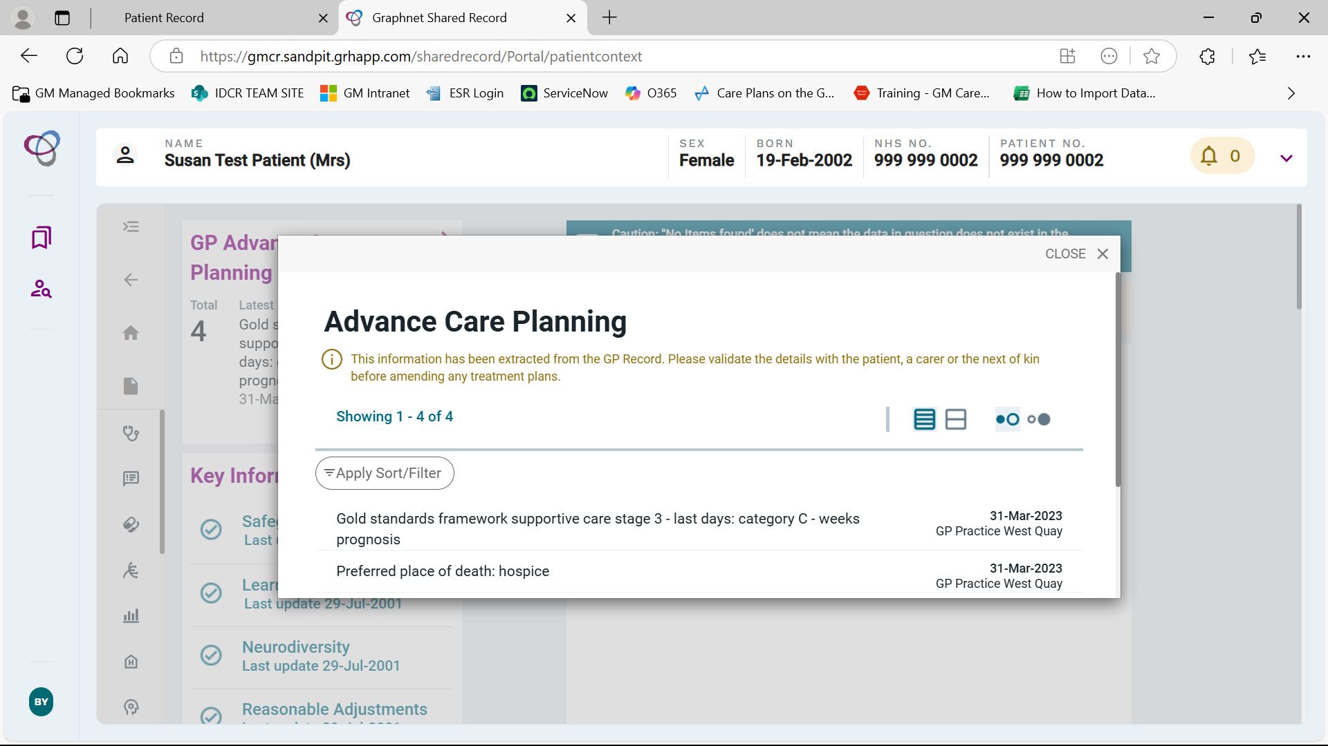
V4 Screenshot

